Slide 1

ROCKBUSTER STEALTH DATA ANALYSIS
BY GIORJEAN MUTUC-NATERA

Slide 2

ROCKBUSTER
Rockbuster Stealth LLC is a movie rental company that used
to have stores around the world. Facing stiff competition from
streaming services such as Netflix and Amazon Prime,
the Rockbuster Stealth management team is planning to use
its existing movie licenses to launch an online video rental
service in order to stay competitive.

Slide 3
KEY QUESTIONS & OBJECTIVES
● Which countries are Rockbuster customers based in?
● Do sales figures vary between geographic regions?
● Which movies contributed the most/least to revenue gain?
● What was the average rental duration for all videos?
● Where are customers with a high lifetime value based?

Slide 4

ROCKBUSTER DATA OVERVIEW
CUSTOMER SPENDING
MIN: $0
MAX: $12
AVG: $4
MOVIE LENGTH (mins)
MIN: 46
MAX: 185
AVG: 115
DAYS AN ITEM IS RENTED
MIN: 3
MAX: 7
AVG: 5
MODE FILM RELEASE YEAR
1999
TIMES AN ITEM IS RENTED
MIN: 1
MAX: 5
AVG: 3
MODE RATING
PG-13

Slide 5
Which countries are rockbuster customers based?

Slide 6

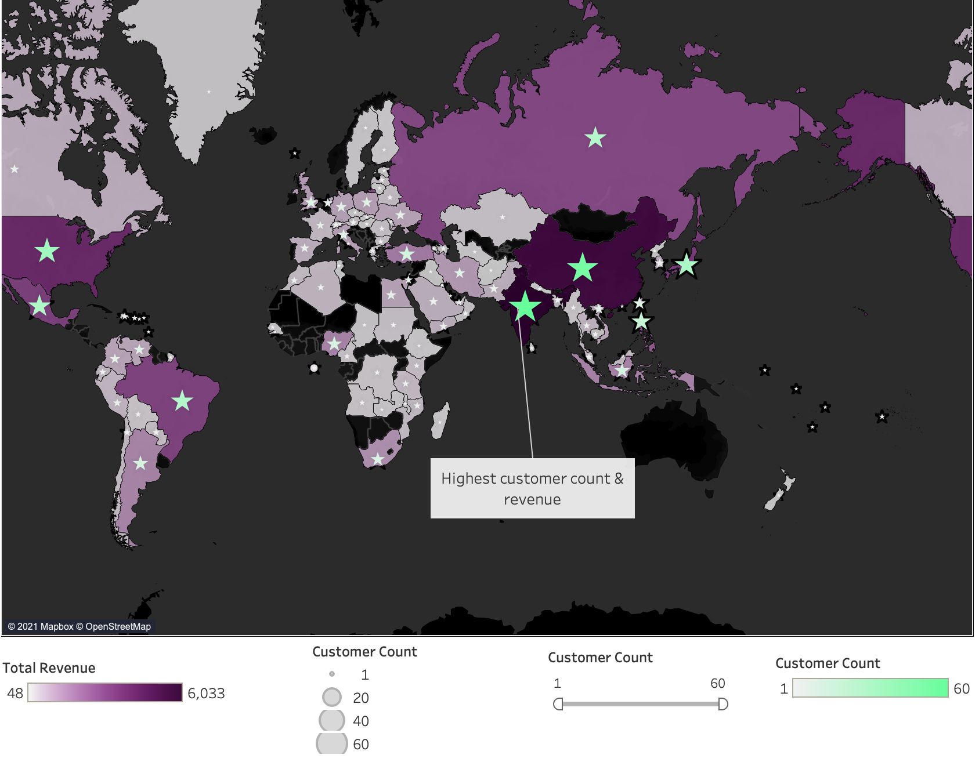


rockbuster’s global reach
TOTAL REVENUE AND CUSTOMER COUNT PER COUNTRY
Present in 108 countries. India has
the highest customer count & revenue.
With 599 registered members
Total of $61,312 in revenue

Slide 7
Do sales figures vary between geographic regions?

Slide 8

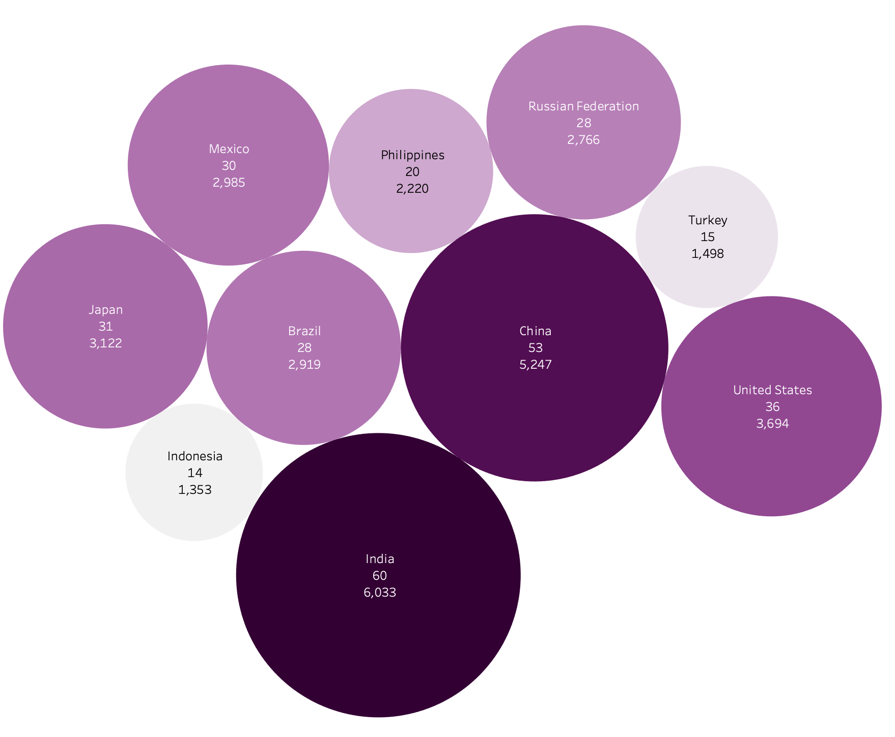
MAGIC 10
Sales vary in each geographic region. But with India, China, U.S., Japan and Mexico topping the list, it appears to be very strong in Asia and North America but not very strong in Europe and Middle East.

Slide 9
Which movies contributed the most and least to revenue gain?

Slide 10
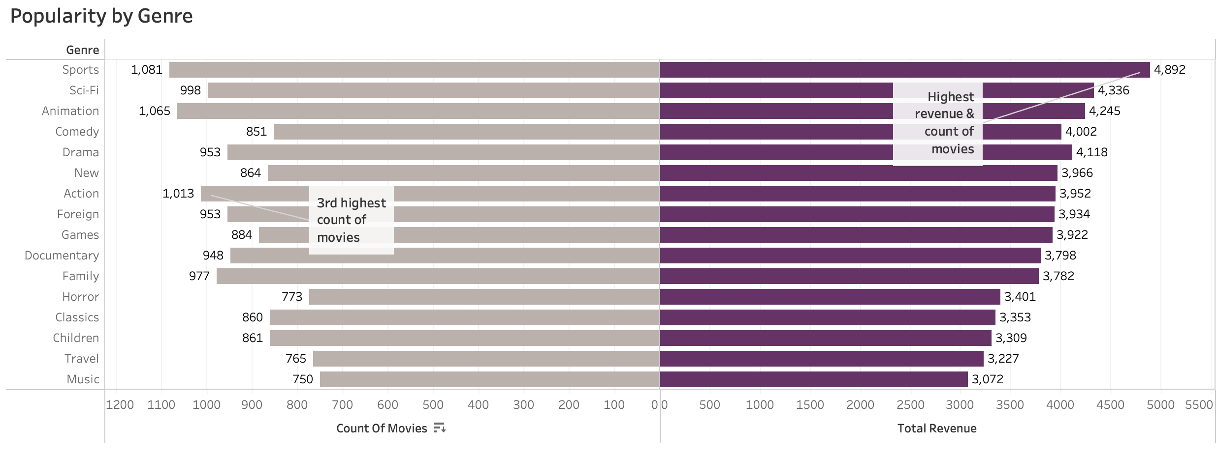



POPULARITY BY REVENUE
Action genre has the highest count of movies but only ranks 7th in terms of revenue.
Sports has the highest count of movies and revenue.
Comedy is the 5th highest in terms of revenue even of its 4th to the last in terms of count.

Slide 11
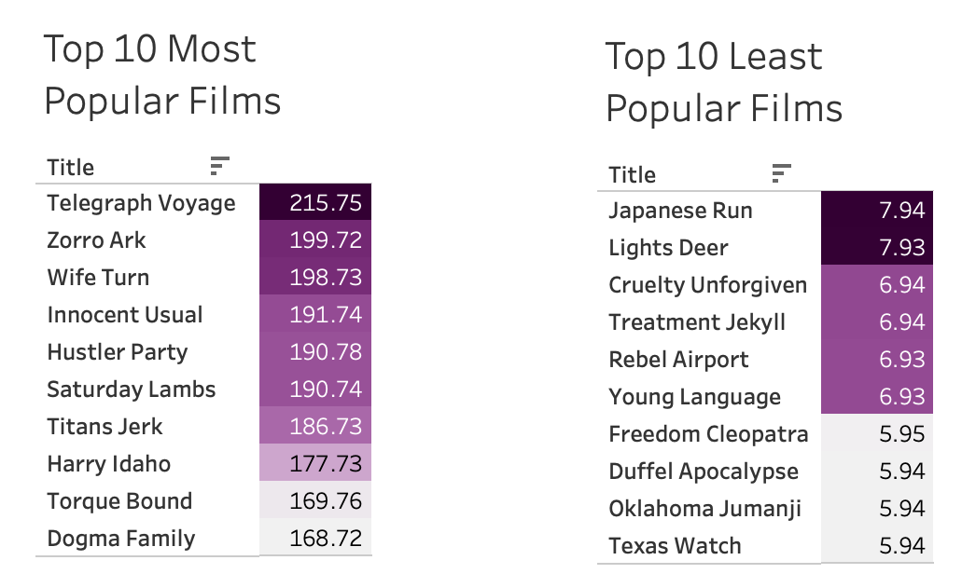
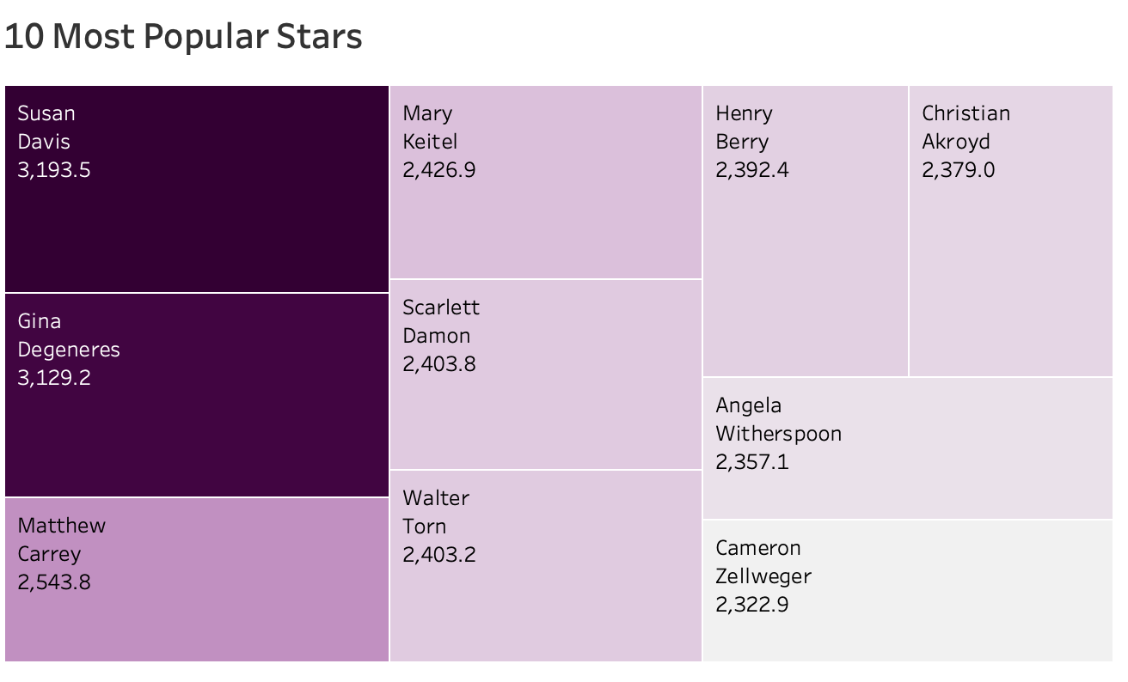

POPULARITY BY REVENUE
These are the 10 best and worst performing movies based on revenue.
It would be good to know the themes and genres
of these titles so purchasing of titles can be data-driven.
It might be helpful to know the movie
titles starring these actors who have
contributed the most revenue.

Slide 12
Where are customers with high lifetime value based?

Slide 13
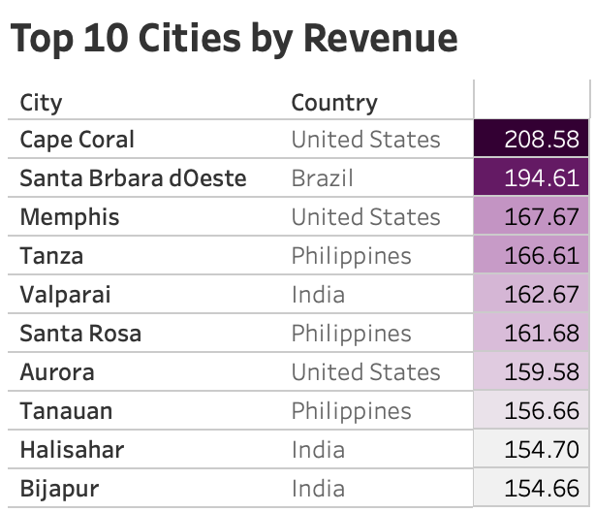
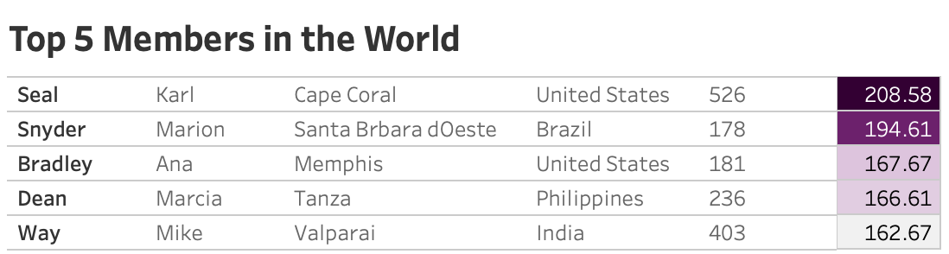

TOP Members
There’s only one subscriber in each of these top cities and
he/she has spent the highest amount in the country.

Slide 14



conclusions & recommendations
Rockbuster should come up with a monthly pricing to compel customers to keep using the platform on a more frequent basis.
Find out how the platform can grow in the Europe, Middle East and Africa.
Rockbuster users are mostly in Asia so it might be beneficial to localise content by getting more movies from Asia (esp for the India and China markets) and also Latin Americas.
Sports, sci-fi and animation has the highest revenue and number of count. Add new titles in these genres.

Slide 15



conclusions & recommendations
Three countries emerge in the top cities in terms of revenue - U.S., India and Philippines but there are only 1 or 2 subscribers (with a strong buying power). These countries are well placed for to have aggressive marketing.
Automate suggestion mechanism using data on the top 10 most popular movies and Top 10 most popular actors. Making these movies and actors visible or associated with the streaming platform can be helpful in marketing Rockbuster.
Devise a rewards system to encourage current and non-members to subscribe to the platform’s streaming transition.

Slide 16

THank you !
Presented by giorjean mutuc-natera

